Slide 1

Literature Review: TinyML-Based Smart Intrusion Detection System with ESP32
BSCE22004
BSCE22025
BSCE22048

Slide 2
Key Enabling Technologies
Model Compression & Quantization Converts 32-bit weights to 8-bit (int8), reducing model size by ~75% while retaining ~97% accuracy.
TensorFlow Lite for Microcontrollers (TFLite Micro) Lightweight, OS-free ML framework for ARM Cortex-M, ESP32, and DSPs; highly portable across platforms.
Edge Impulse Platform End-to-end TinyML development suite with EON Compiler for optimized deployment on microcontrollers like ESP32 and Arduino.

Slide 3
Energy Efficiency Considerations
Battery-powered embedded vision systems demand ultra-low power consumption
ESP32 Case Study
With camera: ~1.25 volts/hour
Without camera: ~0.93 volts/hour
Highlights need for smart power strategies
Optimization techniques
Deep sleep modes
Event-driven activation
Duty-cycled operation for extended battery life

Slide 4

ESP32 Platform for Embedded Vision

Slide 5

ES32 ARCHITECTURE
Why esp32?
Combines processing power, wireless connectivity, and affordability — ideal for embedded ML.
Core specs
Dual-core 32-bit processor @ 240 MHz
520 KB SRAM + up to 16 MB external flash
Parallel processing: one core for networking, one for inference
ESP32-CAM Variant
Integrated OV2640 camera (2 MP)
Supports UXGA (1600×1200), SVGA (800×600), and TinyML-optimized 96×96 resolution
Tailored for vision-based ML tasks

Slide 6
Computational Capabilities and Limitations (ESP32)
Processing Bottlenecks
Complex vision models overwhelm ESP32, causing low frame rates (1–3 FPS) and inference delays.
Memory Constraints
Limited SRAM restricts neural network size and complexity
Camera Initialization Issues
Frequent errors: “camera init failed,” brownout detection, and frame buffer timeouts

Slide 7

Successful Implementation Strategies (ESP32 Vision)
Resolution Optimization Use low-resolution inputs (e.g., 96×96 or 128×128 pixels) to reduce computational load while preserving detection accuracy.
Example: Visual Wake Words dataset uses 96×96 grayscale images for person detection.
Model Architecture Selection Choose lightweight models like MobileNet-SSD or FOMO for resource-constrained devices.
MobileNet uses depthwise separable convolutions to balance efficiency and feature extraction.
Hybrid Edge-Cloud Approaches Combine local inference with cloud-based verification for improved accuracy.
Example: EagleEye project uses local processing with cloud-assisted labeling.

Slide 8
Mobile Architecture
MobileNet & MobileNet-SSD: Efficient use of depthwise separable convolutions makes MobileNet ideal for embedded vision. Used with SSD for real-time detection, achieving over 99% precision for vehicles and 97–99% for person detection in controlled settings. Performance drops in variable lighting and occlusion conditions.​
FOMO (Faster Objects, More Objects): Designed for resource-constrained devices, FOMO predicts object centers rather than bounding boxes, reducing computational cost. Microcontroller tests show F1 scores of 58–95% with inference latency below 1 ms.
TinyYOLO & YOLOv5/v8: YOLO frameworks provide excellent detection, but require careful optimization for microcontrollers. TinysissimoYOLO achieves efficient inference (~3 FPS) with low error counts on edge devices. TinyML studies show FOMO is generally more efficient on constrained platforms

Slide 9
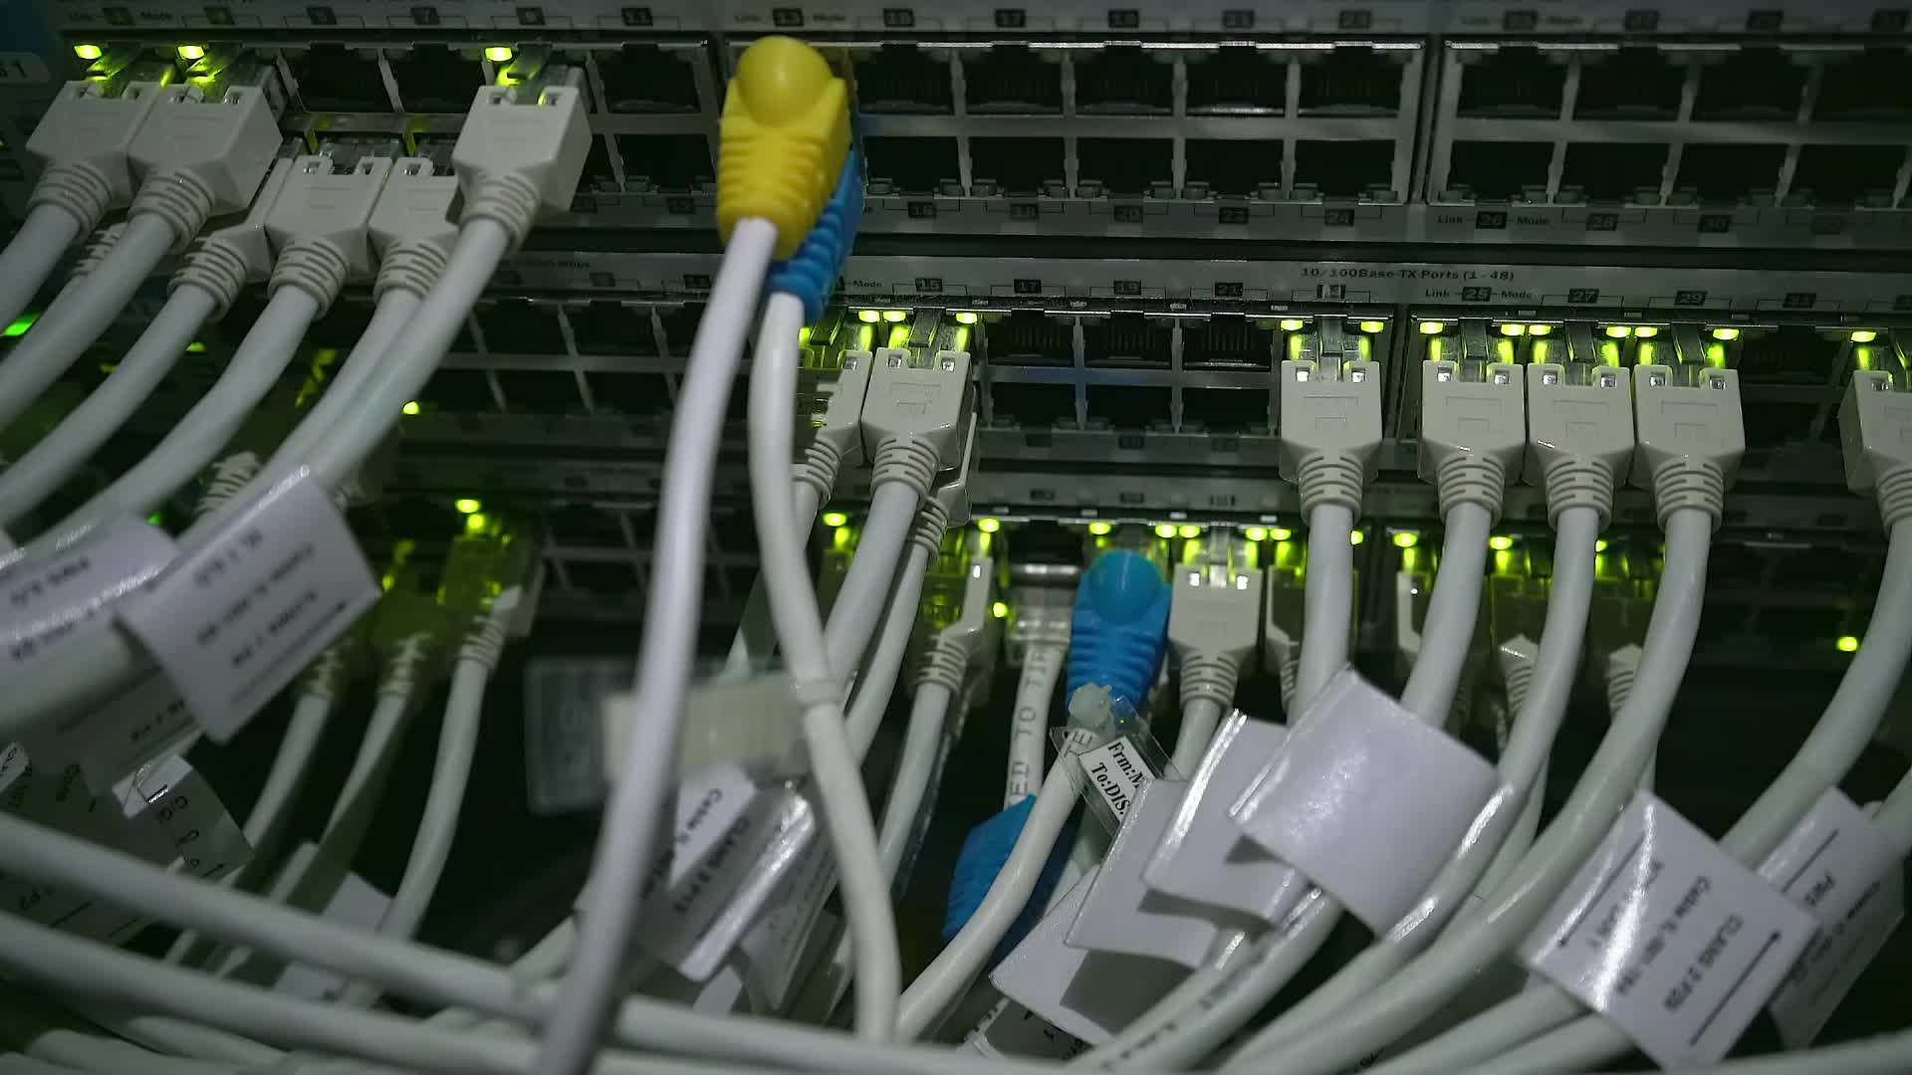
Communication Protocols and WhatsApp Integration

Slide 10

Messaging API Integration for ESP32
CallMeBot API
Function: Provides a straightforward HTTP-based API for sending WhatsApp messages from embedded devices.
Setup: Requires registration of the target phone number and generating an API key.
Mechanism: ESP32 uses HTTP POST requests with URL-encoded content.
Capabilities: Supports text and basic alert transmission.
⚠️ Limitations & Alternatives
CallMeBot imposes rate limits and may have reliability issues during high-volume usage
Image Processing not supported

Slide 11

Alternatives
Telegram Bot API
Offers more robust programmatic access.
Supports image transmission alongside text.
MQTT Publish-Subscribe
Enables decoupled communication between IoT devices and notification services.
SMS via GSM Modules
Provides notification independent of internet connectivity (but at a higher cost).

Slide 12

Real-Time Detection and Response Systems

Slide 13
System Architecture Design
Sensor Fusion for Power Efficiency:
Low-power motion sensors (PIR) trigger the camera only when needed, significantly extending battery life.
On-Device Processing Pipeline:
Trigger → Capture → Process → Detect → Alert
A TinyML model performs person detection directly on the device.
Edge AI for Privacy and Speed:
Processing data locally prevents the transmission of sensitive visual information and allows for fast, intelligent decision-making.

Slide 14
Performance Metrics
Detection Accuracy
The fundamental measure of model effectiveness.
Real-world performance typically ranges from 85-95%, depending on environmental conditions [43].
Latency
Time from event occurrence to notification delivery.
Emergency Systems: Aim for < 500 milliseconds [40].
Doorway Monitoring: 2-5 second delays are generally acceptable.
False Positive Rate
Excessive false alarms reduce user trust and utility.
Target: Achieve rates below 5% in controlled scenarios [26].
Energy Consumption
Critical for battery-powered deployments.
Duty-cycled operation (using motion triggers) can extend battery life from days to months.

Slide 15
Environmental Robustness
Environmental Robustness
Real-world deployments must overcome challenges not found in labs:
Lighting Variations 💡
Challenge: Accuracy degrades significantly in low-light and nighttime conditions.
Solution: Combine image enhancement algorithms (e.g., CLAHE) with suitable neural networks (e.g., VGG16) to improve accuracy (up to 92%) [6, 43].
Occlusions and Partial Views 🚪
Challenge: Doorways often provide only partial body visibility.
Solution: Training datasets must include examples of partial occlusions to ensure robust detection [26].
Weather Conditions 🌧️
Challenge: Rain, fog, and precipitation can degrade image quality in outdoor deployments.
Solution: Requires hardware considerations like weatherproofing and lens protection.

Slide 16

Related Systems and Comparative Analysis

Slide 17
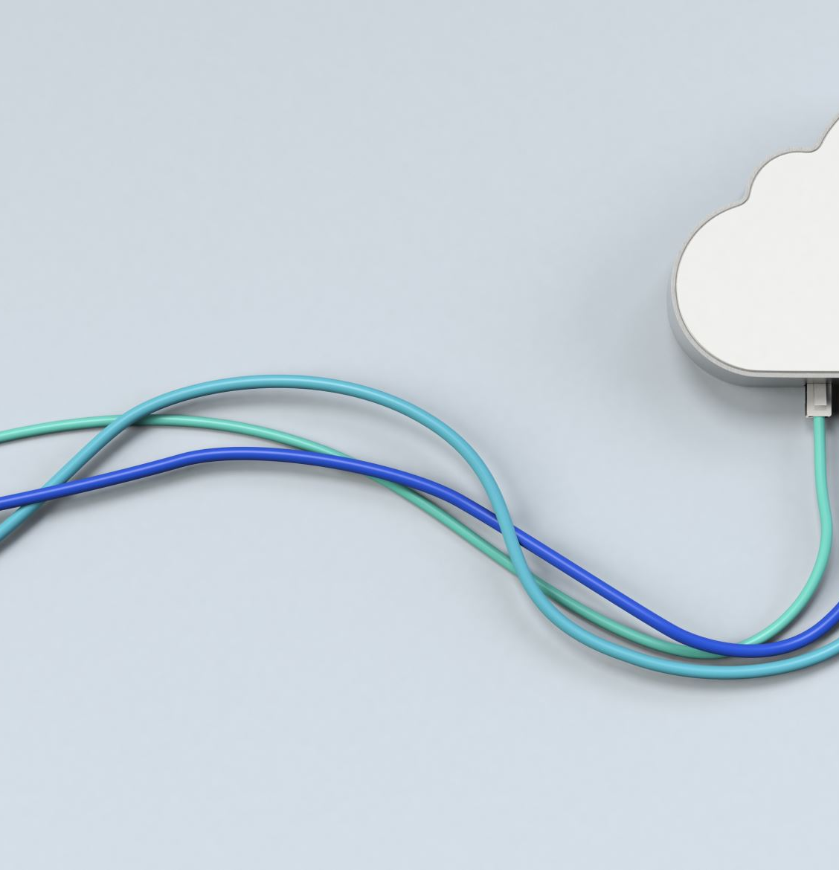
Limitations of Commercial Smart Doorbells
While comprehensive, commercial systems present several drawbacks addressed by edge-based approaches:
Subscription Requirements 💳
Cloud storage and advanced features often require ongoing subscription fees, increasing the total cost of ownership [44].
Privacy Concerns 🔒
Transmitting video data to cloud servers raises privacy issues, heightened by incidents of unauthorized access and data breaches [45].
Connectivity Dependence 🚫
Cloud-reliant systems become non-functional during internet outages, eliminating security coverage when it might be most needed [45]

Slide 18

Related Technologies and Research Areas
Face Recognition Door Lock Systems
Offers enhanced security through biometric authentication [41, 44].
Drawback: Introduces more significant privacy concerns and higher computational requirements compared to simple person detection.
IoT-Based Smart Doorbell (Prototypes)
Research prototypes (e.g., ESP32, Raspberry Pi) validate the feasibility of the technical approach [44, 45].
Limitation: Often lack optimization for production deployment.
Privacy-Preserving Surveillance
Research demonstrates techniques to detect human presence and activity without capturing identifiable visual information [45].
Methods: Includes skeletal tracking, silhouette detection, or encrypted visual features.

Slide 19

Comparative Advantages of the EagleEye Approach
The EagleEye system distinguishes itself through several key design choices:
Local Processing 🔒
Complete person detection inference executes on-device [1, 2].
Eliminates cloud dependence and protects user privacy.
Cost Effectiveness 💰
Utilizes affordable commodity hardware (e.g., ESP32-CAM @ $10-15) [46].
Avoids high initial costs ($100-$200) and recurring subscriptions.
Minimal Latency ⚡
Edge processing eliminates network round-trip delays.
Enables sub-second response times.
Independence from Internet 🚫
Core detection functionality operates with intermittent or no connectivity.
Network access is only required for sending notifications.

Slide 20
Challenges and Limitations

Slide 21
Technical Constraints
Limitations and Trade-offs
Computational Limitations ⏱️
Platform: The ESP32 imposes strict constraints on model complexity and speed.
Performance: Achieves 1-3 FPS for person detection, which is acceptable for doorway monitoring but not for continuous video surveillance [15, 18, 20, 21, 25].
Model Size Restrictions 💾
Flash: TinyML models must fit within approximately 400-500 KB of flash memory.
RAM: Must use less than 200 KB of RAM during inference.
Solution: Requires careful architecture selection and aggressive model compression.
Accuracy-Efficiency Trade-offs ⚖️
Reducing model complexity to meet resource constraints inevitably impacts detection accuracy.
TinyML models are more sensitive to dataset quality than larger models, requiring careful dataset curation [26].

Slide 22
Conclusion

Slide 23
The New Opportunity
The Convergence: TinyML, edge computing, and affordable embedded hardware create new opportunities for intelligent, privacy-preserving security systems.
The Approach: ESP32-based person detection with local processing is a technically feasible approach that solves key problems of cloud-dependent systems.
Key Finding 1: Technical Feasibility
Research shows optimized neural networks can run on ESP32 hardware at acceptable frame rates (1-3 FPS) and accuracy (85-95%) [2, 15, 26].
Key Finding 2: Energy Viability
TinyML offers dramatic energy efficiency, enabling extended battery operation when paired with smart power management [6, 35].

Slide 24
Key Advantages & Challenges
Local processing fundamentally addresses privacy concerns by eliminating the need to send visual data to external servers [2, 34].
Key Finding 4: Cost Effectiveness
Using commodity hardware (e.g., ESP32-CAM @ $10-15) makes intelligent monitoring accessible, avoiding high upfront costs and subscriptions [8].
Key Finding 5: Integration Challenges
Success requires careful model optimization, power management, and environmental robustness.
The ESP32 platform imposes real constraints, forcing trade-offs between capability and resource use.

